Slide 1

Summer 2025
Proof & Experimental Establishment (PXE), DRDO – Chandipur
Study of High-Speed Imaging Techniques and
Design & Development of a Flash Detector Circuit
Under the Guidance of:
Mr. Prem Kumar Sahani (Scientist-D)
Presented by:
Keshab Patro
B.Tech, 3rd year
Department of Electrical Engg.
National Institute of Technology, Rourkela

Slide 2
Contents:
Overview of DRDO, PXE and Key Products
Hands-on Experience with High-Speed camera
Experiment 1(a): Human Reaction Time –
Single individual
Two individuals
Experiment 1(b): Determination of Supply Frequency Using a Fluorescent Tubelight
Experiment 2: Flash Triggering Circuit -1
Shortcomings/ Limitations
Suggestions by the Director (PXE)
Practical implementation of Flash Triggering Circuit
Fastest possible Flash Triggering Circuit
Constraints

Slide 3


Slide 4

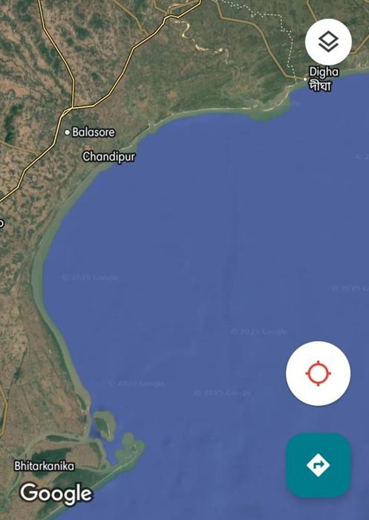

Slide 5

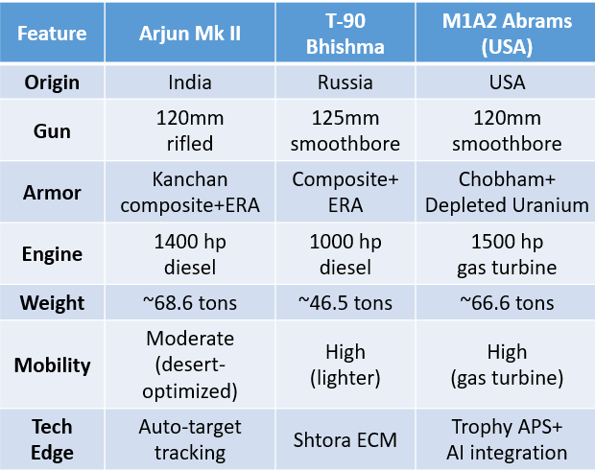

Slide 6
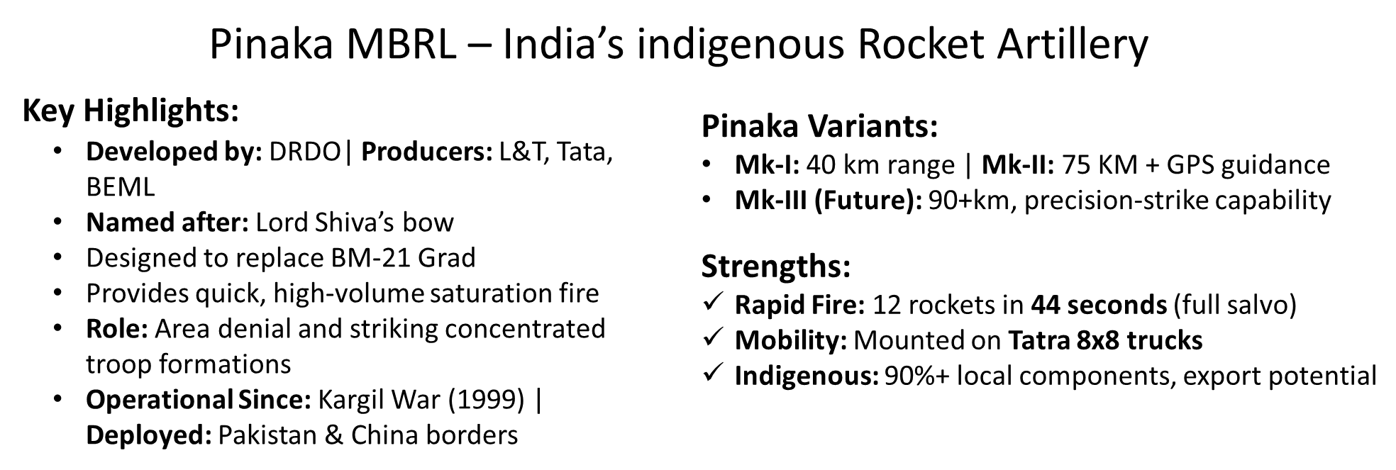
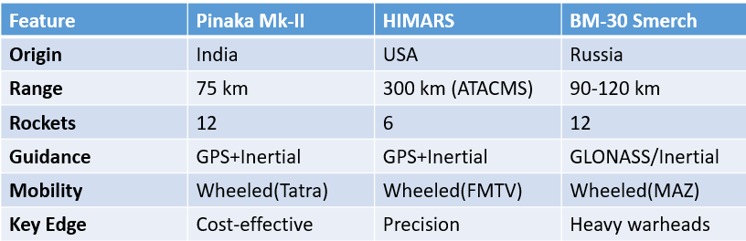

Slide 7

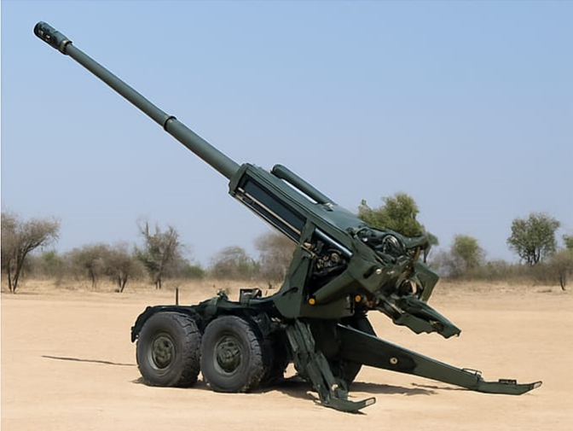
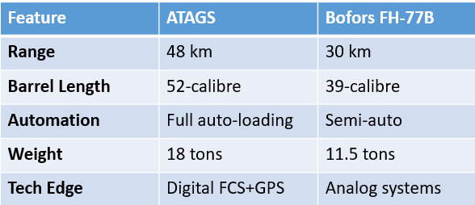

Slide 8
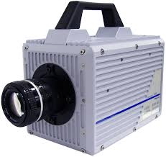
Hands-on Experience with High-Speed camera
PHOTRON FASTCAM SA5 – Key Specifications
Frame Rate:
Up to 7,500 fps at full resolution (1,024 × 1,024 pixels)
Up to 775,000 fps at reduced resolution (128 × 24 pixels)
Sensor Type:
12-bit CMOS sensor (monochrome)
Pixel size: 20 µm
Exposure Time:
As low as 369 nanoseconds
Typical minimum exposure time: 1 microsecond
Control Interface:
Standalone operation using 5-inch LCD keypad
Software control via Photron FASTCAM Viewer (PFV)
Applications:
Ballistics (e.g., visualizing muzzle flash and projectile motion)
Particle Image Velocimetry (PIV)
Combustion and explosion analysis
Aerospace

Slide 9
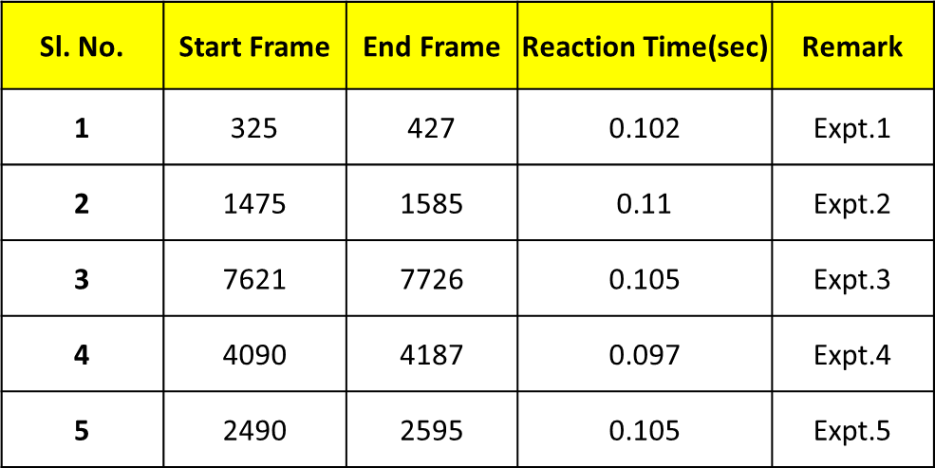
Experiment- 1(a)
Human Reaction Time – Single individual
Objective:
To measure the reaction time of a single individual in response to a specific stimulus
To assess sensory-motor coordination, cognitive processing speed and responsiveness
Method:
A ruler is dropped from a fixed height.
The entire action is recorded using a high-speed camera.
Reaction time is calculated by:
Identifying the frame where the ruler is released
Identifying the frame where it is caught
Applying the formula:
Result:
Average human reaction time = 0.1038 sec
= 103.8 msec
Response frame – Stimulus frame
Reaction time =
___________________________
Here, Frame rate = 1000 fps
Frame Rate

Slide 10
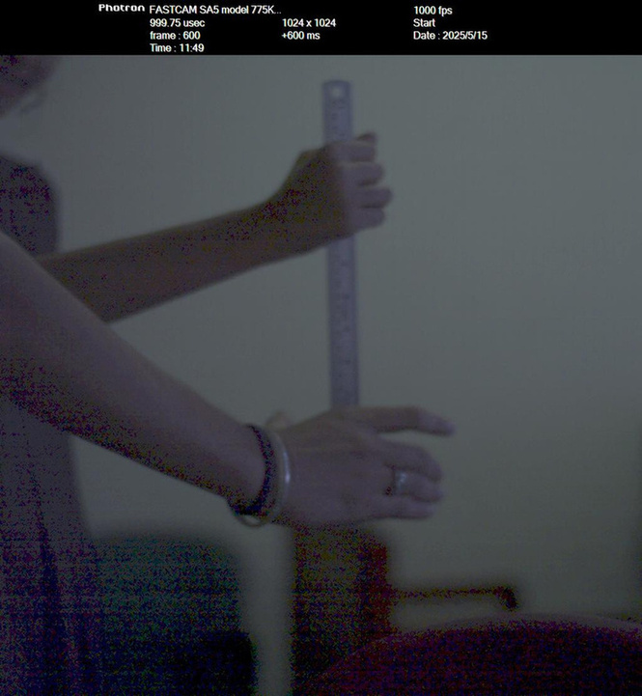
Human Reaction Time – Two individuals
Objective
To compare the reaction times of two individuals in response to a stimulus
To analyse differences in:
Cognitive processing speed
Motor coordination
Attention and decision-making ability
Method:
A ruler is dropped from a fixed height.
The entire action is recorded using a high-speed camera.
Reaction time is calculated by:
Identifying the frame where the ruler is released
Identifying the frame where it is caught
Applying the formula:
___________________________
Response frame – Stimulus frame
Reaction time =
Frame Rate

Slide 11
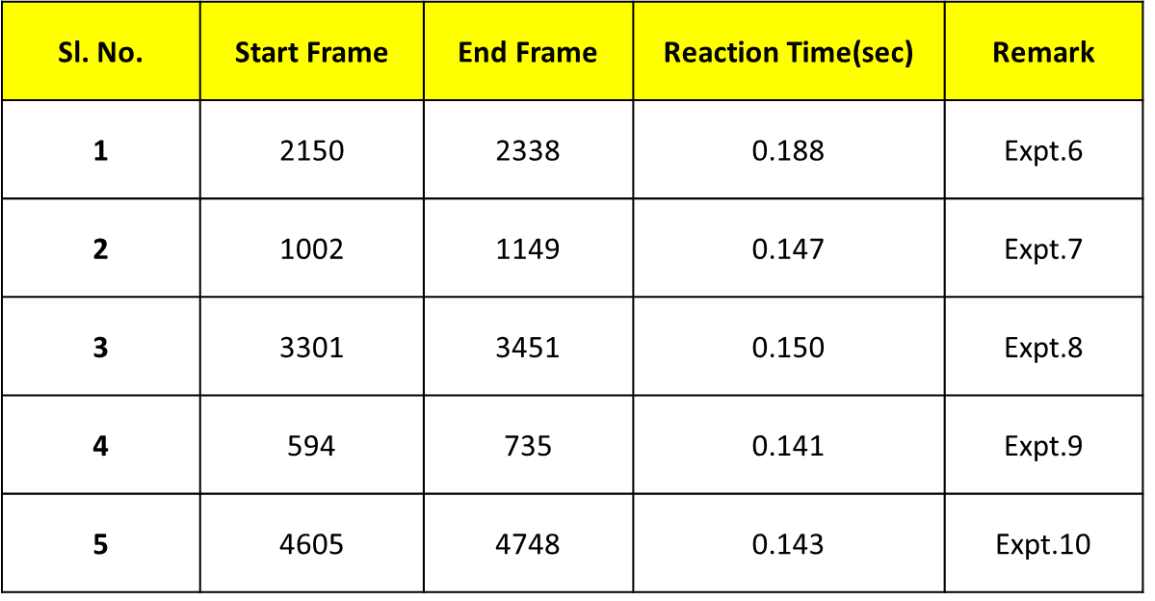
Two individuals:
Average human reaction time = 0.1538 sec = 153.8 msec

Slide 12
Experiment- 1(b)
Determination of Supply Frequency Using a Fluorescent Tubelight
Procedure:
Frame rate was set to 250, 500 and 1000 fps on the high-speed camera
Camera was focused on a fixed point on the tubelight
For each frame, RGB values at that point were recorded
Graphs plotted:
R, G, B channel values vs. time
Average brightness (mean of R, G, B) vs. time
Perceived luminance vs. time
Perceived Luminance = 0.2126R + 0.7152G + 0.0722B
Supply frequency determined by analyzing the periodicity of the brightness/luminance graph or RGB values

Slide 13
For Frame rate = 250 fps
For Frame rate = 500 fps

Slide 14
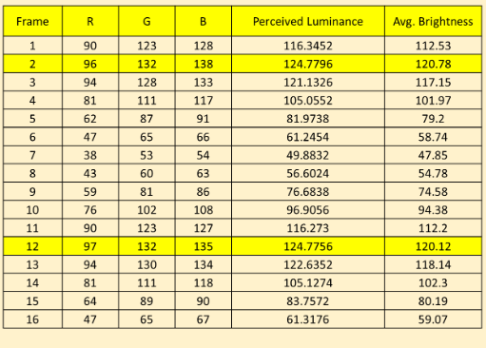
For Frame rate = 1000 fps
12-2 = 10 frames
1000 frames = 1 sec
10 frames = 0.01 sec = 10 msec = gap b/w 2 peaks
So, time period = 20 msec OR supply freq. = 50 Hz

Slide 15
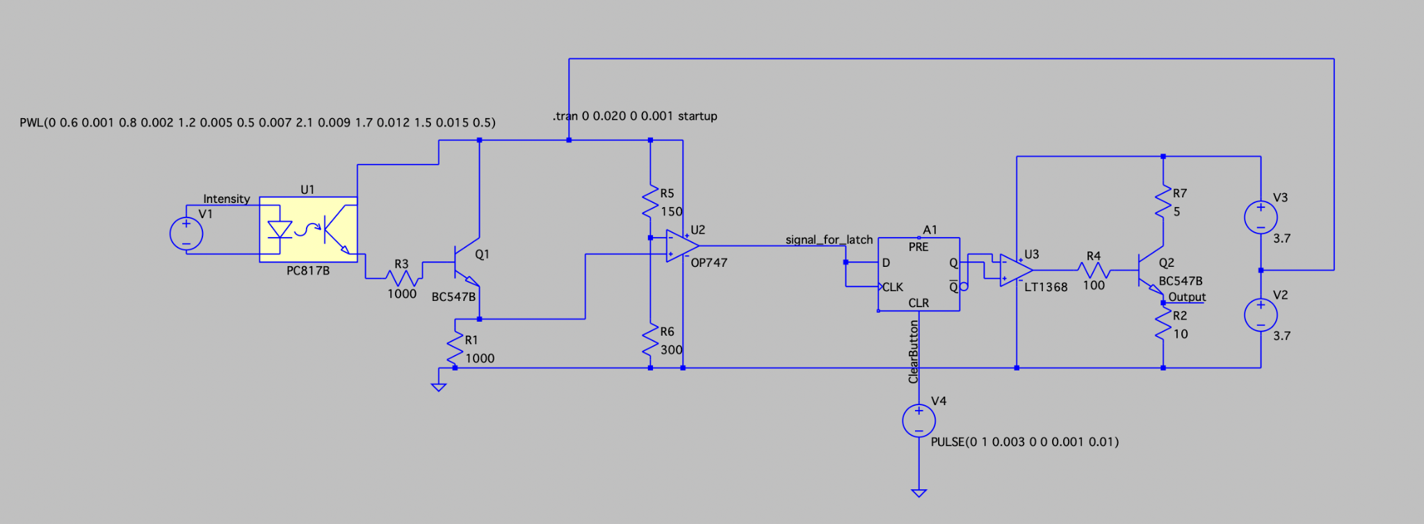
Experiment- 2
Flash Triggering Circuit – Design 1
Objective:
To design and implement a flash triggering circuit that detects the flash generated during the firing of a gun and provides a corresponding 5V output signal which will be then used to trigger a camera.

Slide 16
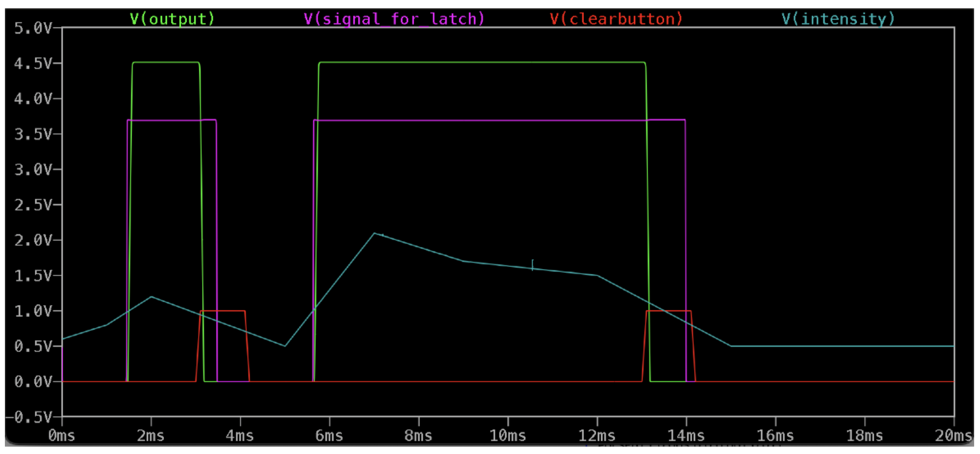
Simulation Results:
The circuit performed satisfactorily both in SPICE simulation and real life testing, supporting loads as high as 0.45 A by producing a sharp pulse due to light intensity variation.
Triggering Waveform based on Intensity Variation

Slide 17
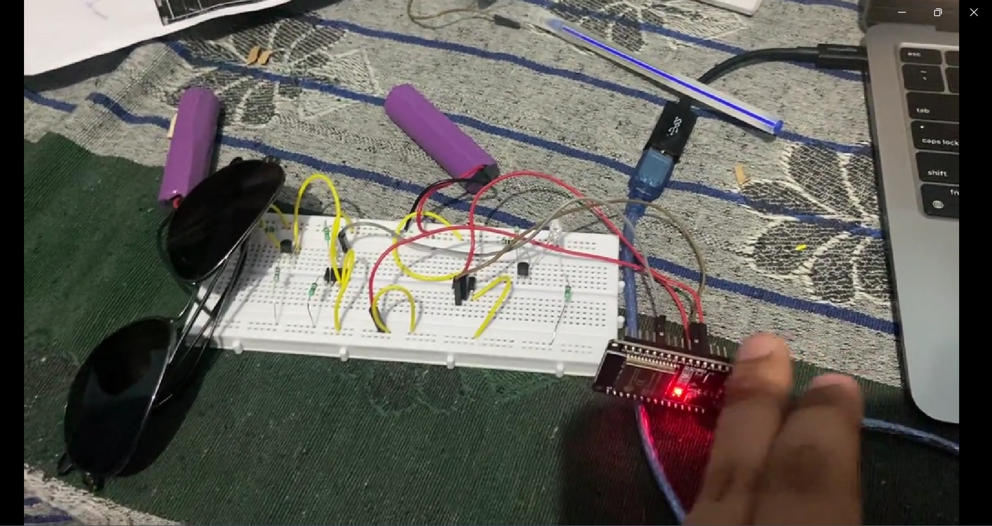
Video of Flash Triggering Circuit – Design 1

Slide 18
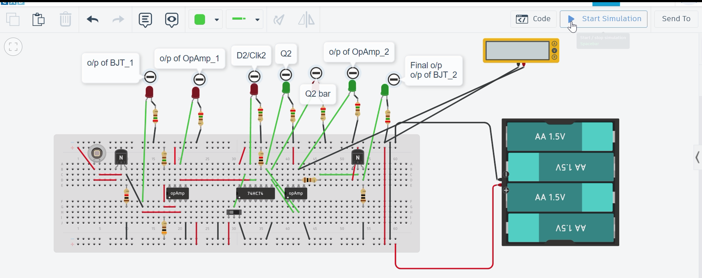
Simulation of Flash Triggering Circuit (Design 1) on Tinkercad
Note: The measured output voltage was 5V in practical testing.

Slide 19
Shortcomings/ Limitations:
The theoretical delay of the circuit is
LDR + BC547 + UA741 + D flip flop (74LS74) + UA741 + BC547
= 100 ms + 100 ns + 20 us + 30 ns + 20 us + 100 ns
= 100 ms + 230 ns + 40 us
= 100.04023 ms
Sunlight filtering is not integrated with the LDR and temporarily implemented here using a sunglass.
Recommendations from the Director(PXE):
Minimize the circuit delay to < 1 us
(sub-microsecond level)
Target further optimization for nanosecond (ns) range if feasible

Slide 20
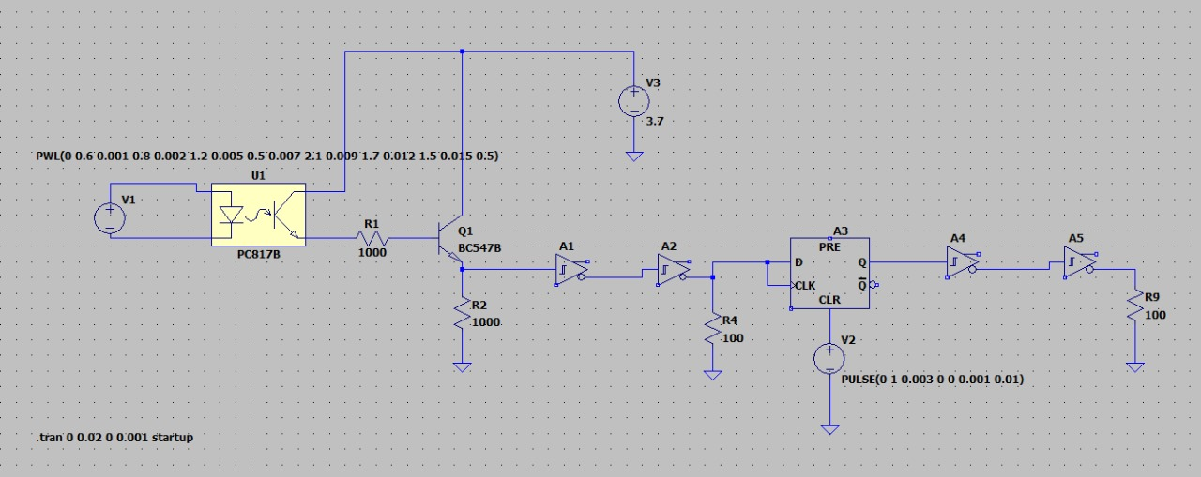
Practical implementation of Flash Triggering Circuit:
Changes implemented:
Replaced the Op-Amp (UA741) and the RTL-based amplification circuit with a TTL logic-based solution using the 74LS14 (Hex Schmitt Trigger Inverter).

Slide 21
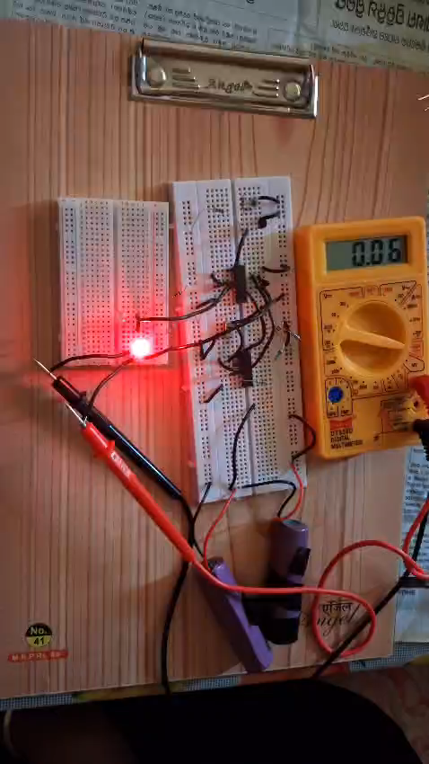
Video of Flash Triggering Circuit

Slide 22
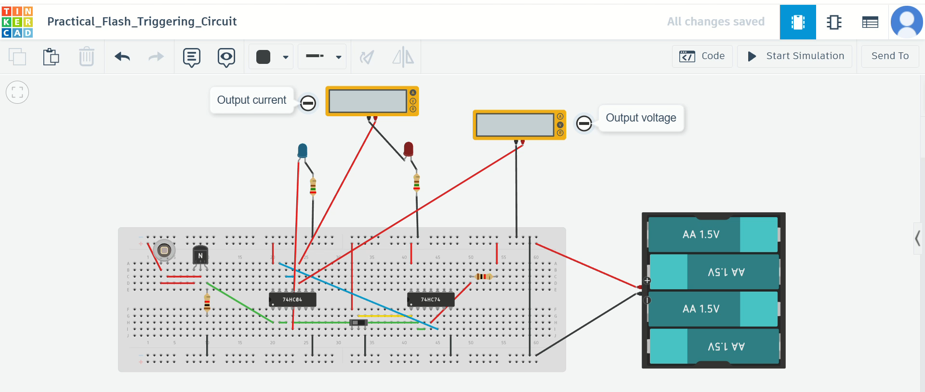
Simulation on Tinkercad
Note: The measured output voltage was 5V and output current was 60-70mA in practical testing.

Slide 23
Theoretical delay calculation:
1. Photodiode (BPW34) Response
Rise Time (10%→90%): 100ns (datasheet value)
Junction Capacitance: 40pF @ 5V reverse bias
RC Time Constant: With 10kΩ load resistor (typical for BPW34 circuits): τ = R × C = 10kΩ × 40pF = 400ns → Actual response ≈ 2.2τ = 880ns
2. BJT Amplifier (BC547) Delay
Transition Frequency (fₜ): 100MHz
Switching Delay: t_delay = 1/(2π × fₜ) ≈ 1.6ns (theoretical) But with parasitic board capacitance (~15pF): τ = R_load × C_parasitic = 1kΩ × 15pF = 15ns → Total stage delay ≈ 20ns
3. 74HC04 Schmitt Trigger
Propagation Delay (Vcc=5V): 15ns (datasheet max)
Two Inverters in Series: 15ns × 2 = 30ns

Slide 24
4. 74HC74 D Flip-Flop
Clock-to-Q Delay: 25ns (datasheet max @ 5V)
Setup Time: 20ns (must be stable before clock edge) → Total DFF delay ≈ 45ns
5. Output Inverter Chain
Two more 74HC04 inverters: 15ns × 2 = 30ns
Cumulative Delay
Stage | Delay Contribution
BPW34 | 880ns
BC547 | 20ns
1st Inverter Pair | 30ns
74HC74 DFF | 45ns
Output Inverters | 30ns
Total | 1,005ns (≈1μs)

Slide 25
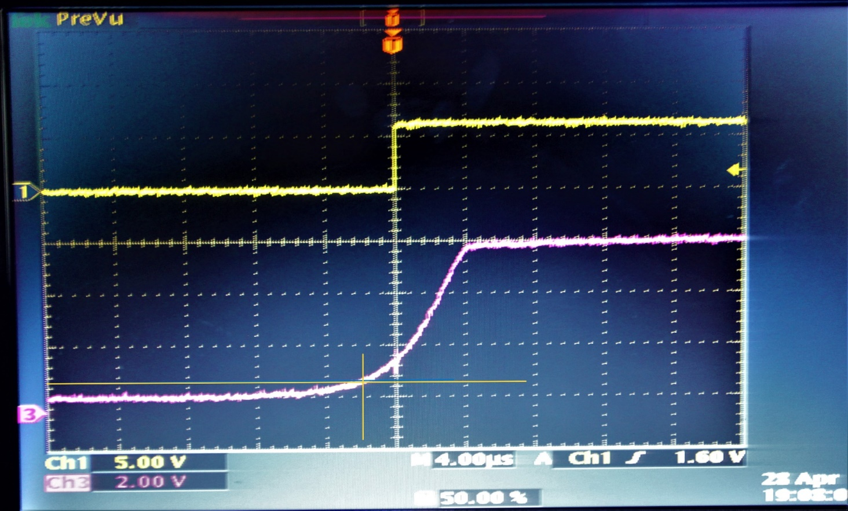
Practical delay of this circuit measured using oscilloscope:
output
input
Input rises gradually to ~6 V after light detection.
Delay is measured from 10% level (0.6 V) to output transition.
Estimated delay ≈ 2 µs.

Slide 26
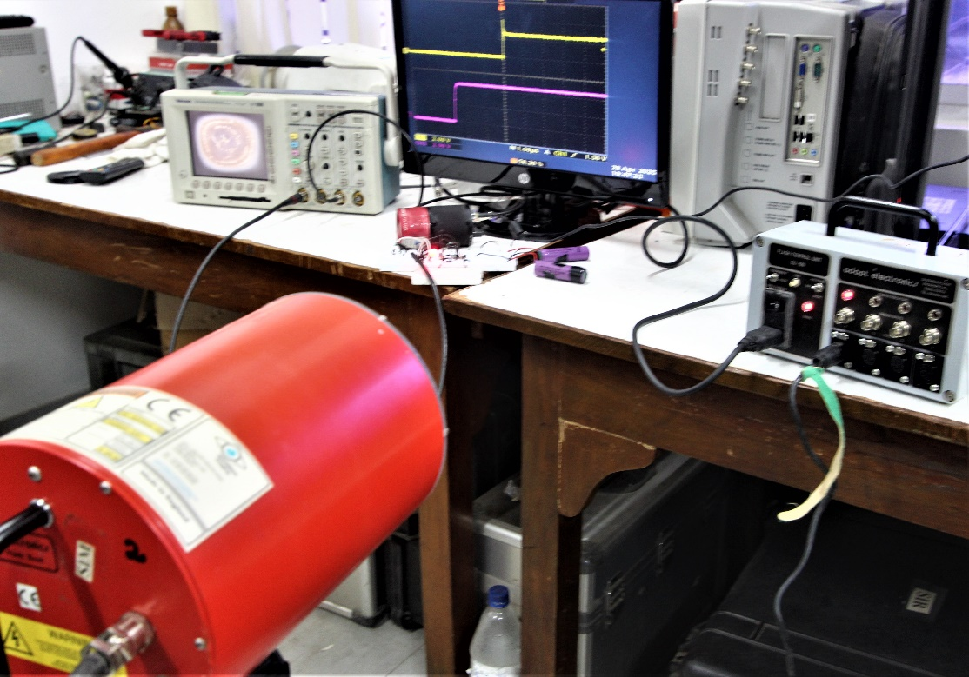
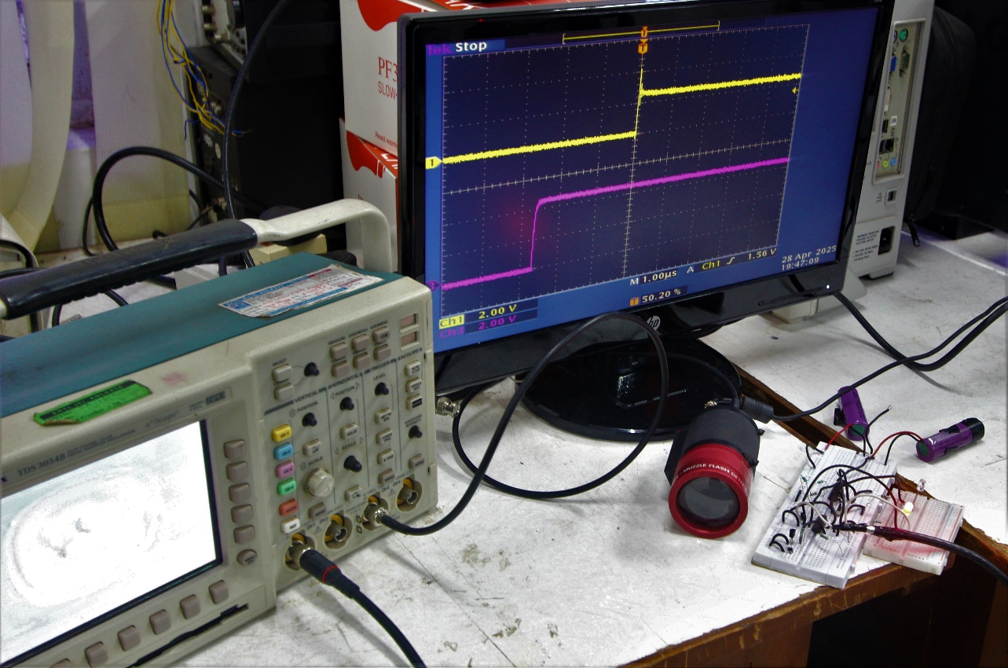
Comparison with standard Flash Detectors available at PXE:
Experimental Setup:

Slide 27
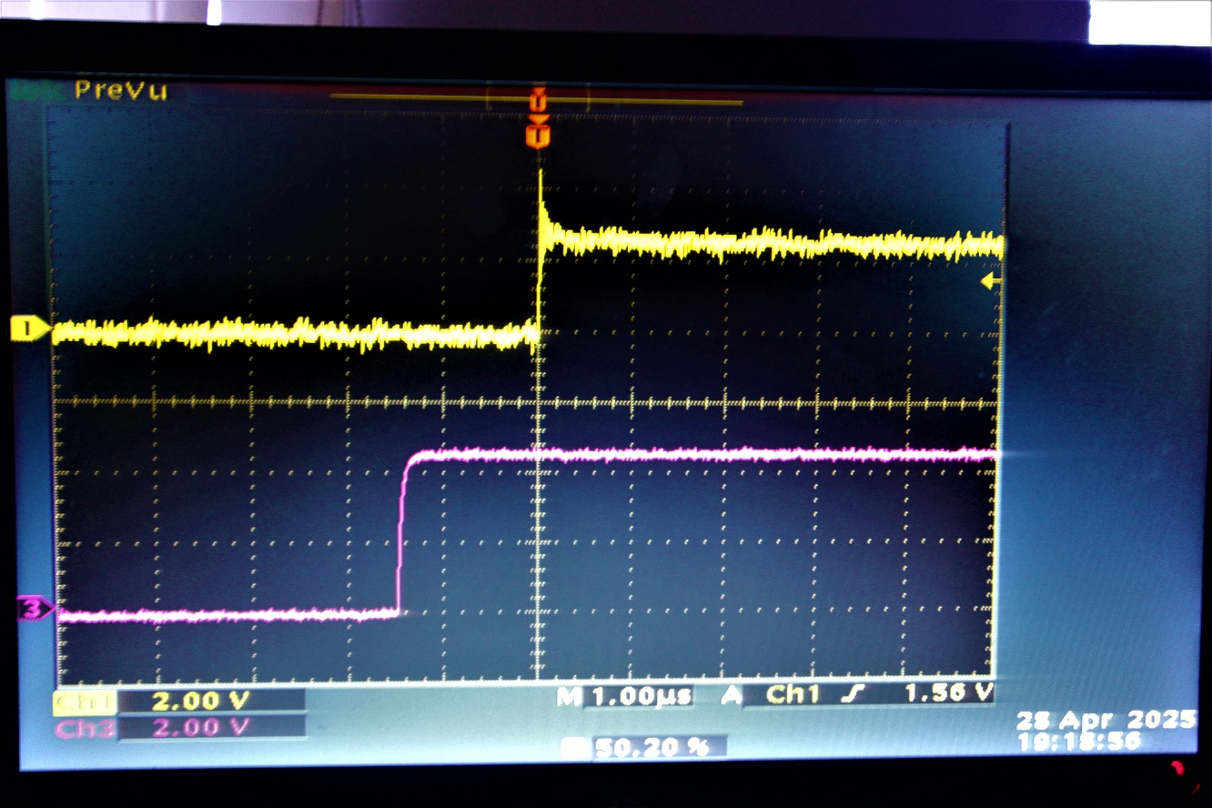
Comparison with standard Flash Detector-1:
Delay between the standard Flash Detector & the implemented design = 1.5-1.6 µs

Slide 28
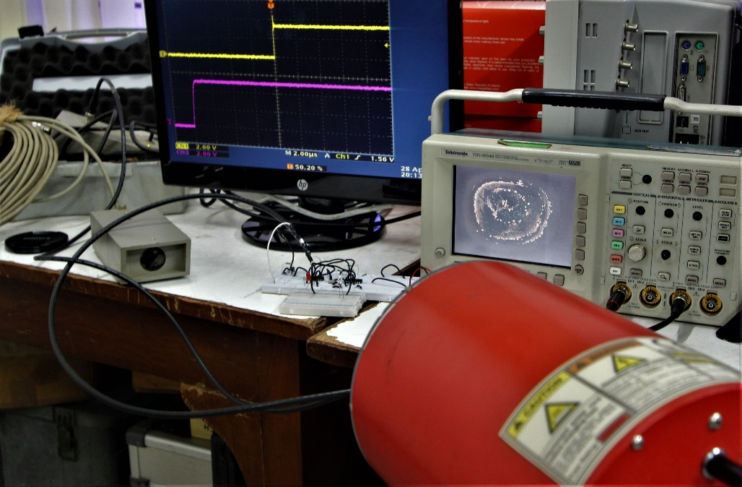
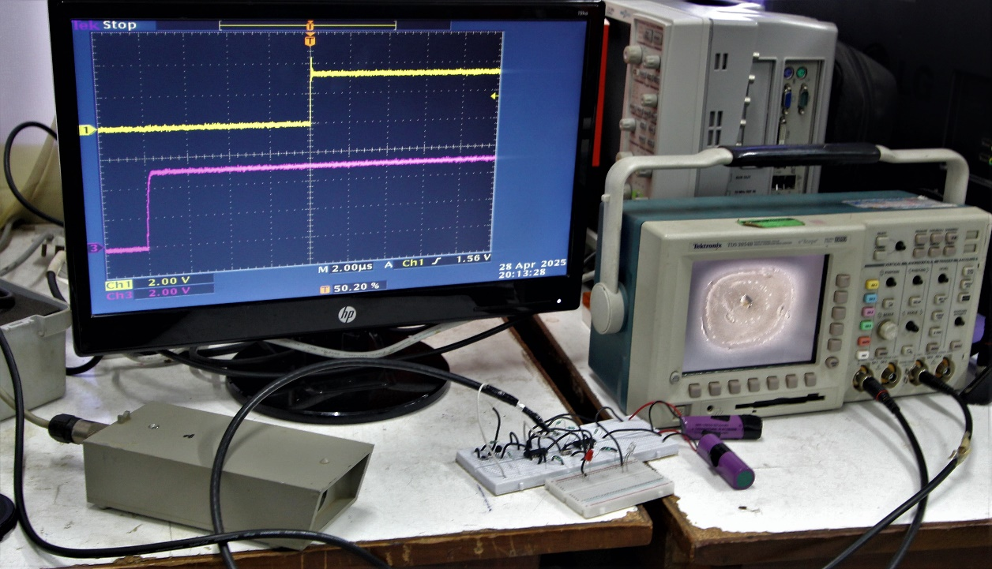
Comparison with standard Flash Detector-2:
Experimental Setup:

Slide 29
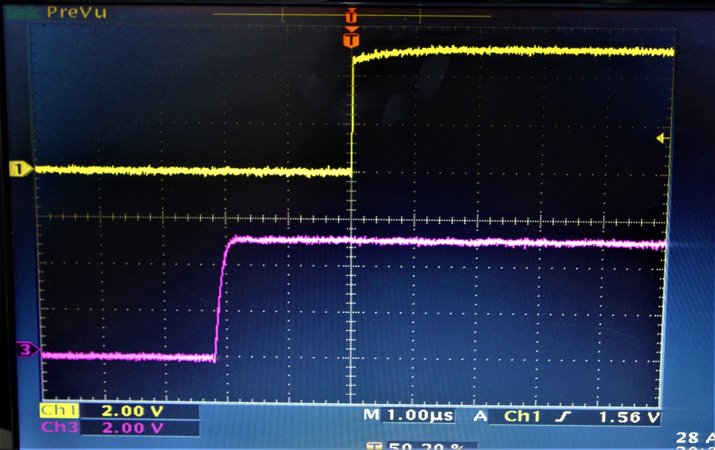
Comparison with standard Flash Detector-2:
Delay between the standard Flash Detector & the implemented design = 2.2 µs
(ambient light condition)

Slide 30
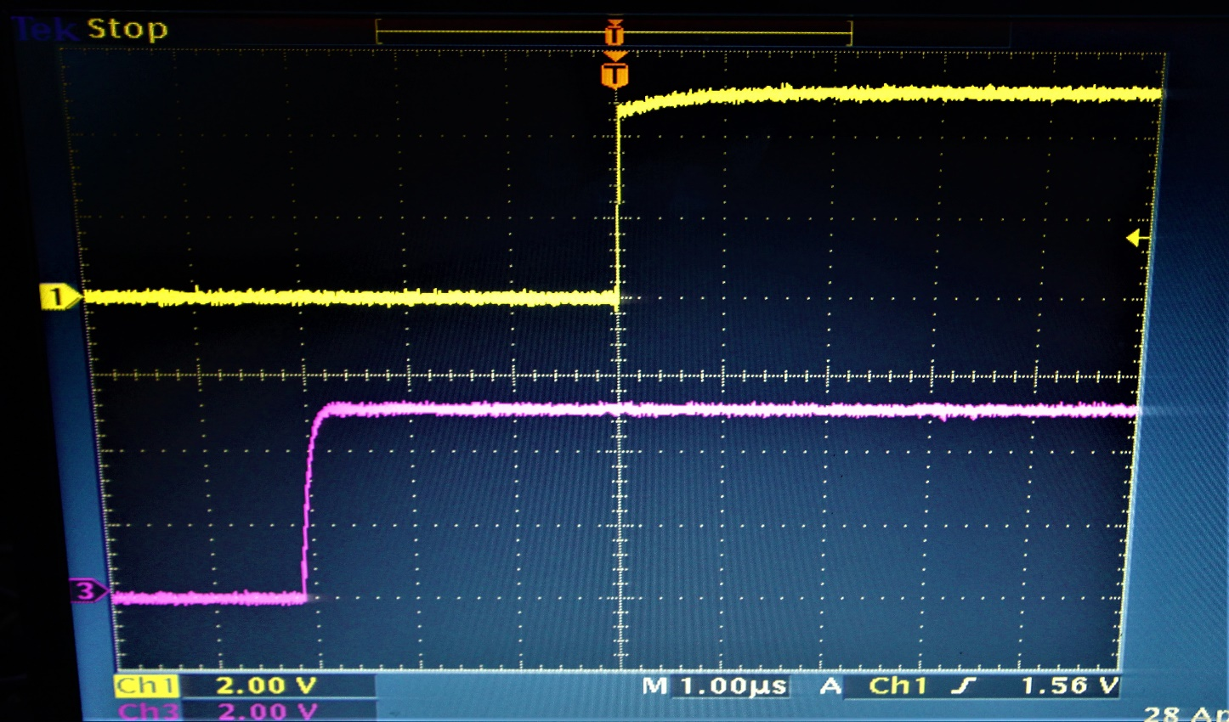
Comparison with standard Flash Detector-2:
Delay between the standard Flash Detector & the implemented design = 3 µs
(no light condition)

Slide 31
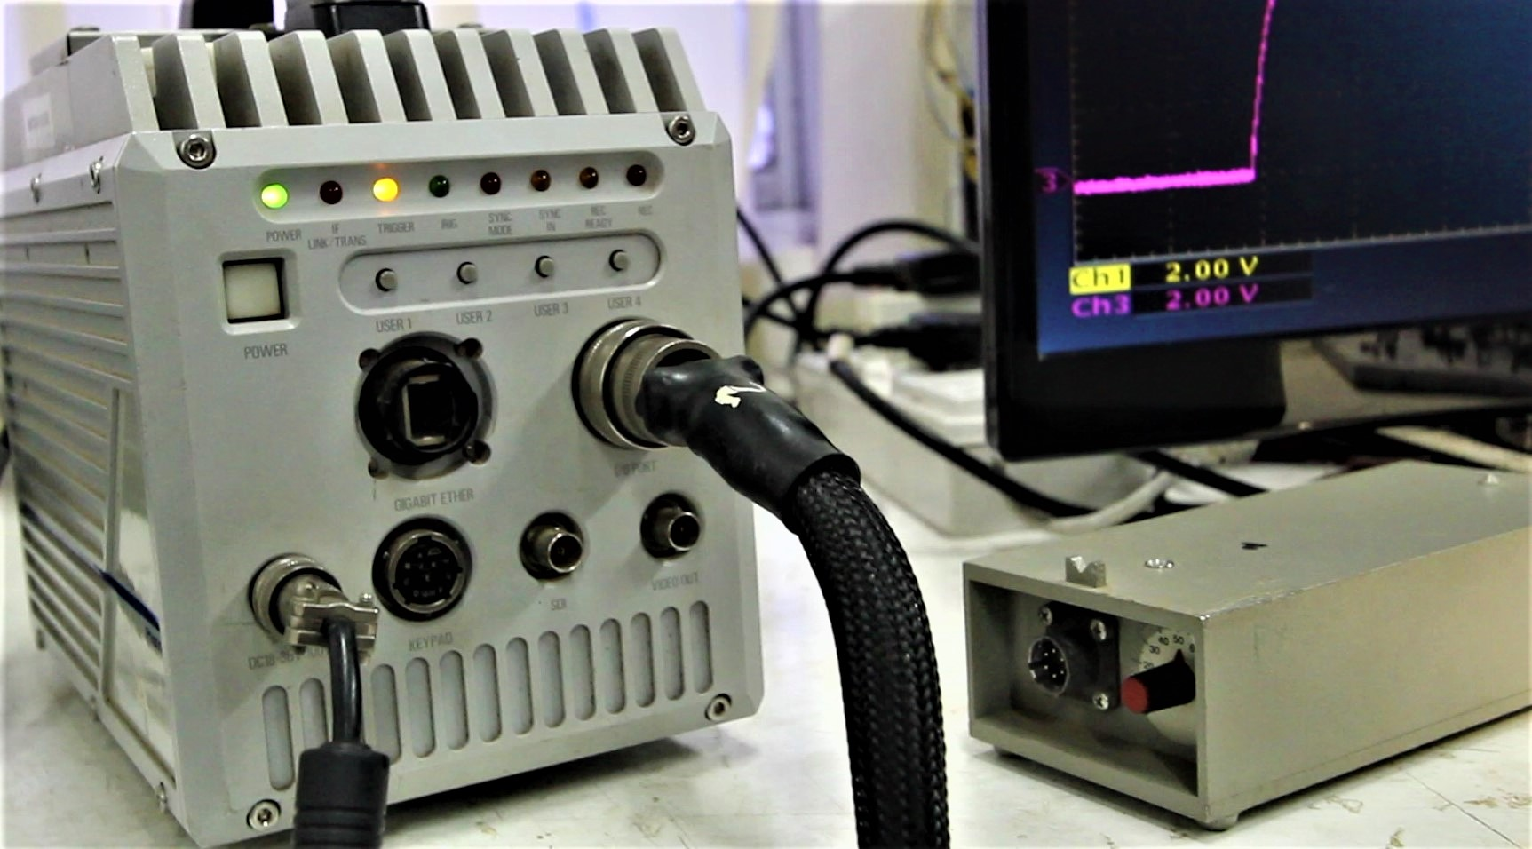
Triggering Fastcam SA5 using the implemented design:
Note: in the previous 2 slides, the o/p voltage is 5 volts, sufficient enough to trigger the camera.

Slide 32
Fastest possible Flash Triggering Circuit
(Theoretical Maximum Performance Implementation)
Theoretical maximum delay time = 1.05ns
(Total latency)

Slide 33
Component Replacements & Specifications:
Original | Advanced Replacement | Key Parameters | Where to Buy
BPW34 Photodiode | Hamamatsu G11193 SiPD | 0.5ns rise time, 15pF @ 12V | Digi-Key #1480-1032-ND
BC547 BJT | MACOM MA4-1315 GaAs HBT | 25GHz, 0.1ns switching | Mouser #894-MA4-1315-ITR1
74HC04 Inverter | Hittite HMC86 GaAs Inverter | 0.05ns delay, 5V operation | Arrow Electronics
74HC74 DFF | Renesas HMC7043 GaAs DFF | 0.25ns clk-to-Q, 5V tolerant | Renesas Direct

Slide 34
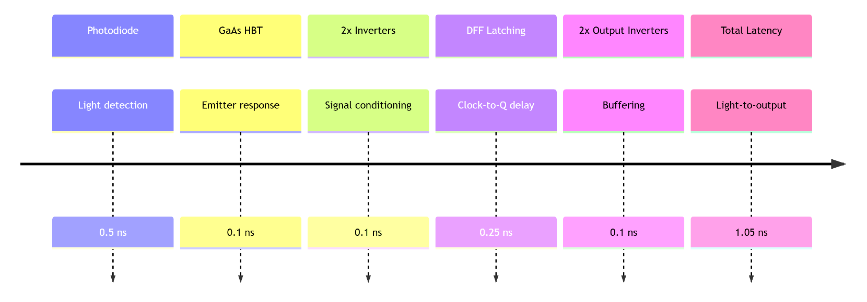
Signal Flow Architecture & Delay calculation:

Slide 35
Performance Comparison:
Parameter | Original | Upgraded | Improvement
Latency | ~2μs | 1.05ns | 1900x
Max Trigger Rate | 10kHz | 500MHz | 50,000x
Sensitivity | 100μW | 5nW | 20,000x

Slide 36
Implementation Constraints:
(With Practical Alternatives)
1. Cost & Availability Challenges
A. Premium Components (Theoretical Max Performance)
Component | Example Part | Price (1pc) | Lead Time
Photodiode | Hamamatsu G11193 | $420 | 18 weeks
Amplifier | MACOM MA4-1315 | $380 | 12 weeks
DFF | Renesas HMC7043 | $270 | 26 weeks
B. Practical Alternatives (90% Performance, 10% Cost)
Component | Alternative Part | Price | Performance Penalty
Photodiode | Thorlabs DET025AFC | $85 | 1ns vs 0.5ns
Amplifier | ON Semi NBSG86 | $22 | 0.15ns vs 0.1ns
DFF | TI SN74AXC1G74 | $1.20 | 3.5ns vs 0.25ns

Slide 37
2. Severe Availability Challenges
Component | Lead Time | Stock Status (Digi-Key/Mouser)
G11193 SiPD | 18 weeks | "Factory Order"
MA4-1315 | 12 weeks | "No Stock"
HMC7043 | 26 weeks | "Military Supply Chain"
3. Procurement Challenges:
a. Requires RF specialty distributors (Richardson RFPD, etc.)
b. 12-16 week lead times common
c. Not stocked on: Robu.in, Quartz Components, LCSC
4. Fabrication Demands:
a. Rogers 4350B PCB substrate ($500/panel)
b. Laser-drilled vias for 25GHz signals

Slide 38
5. Side-by-Side Comparison
Parameter | Theoretical Max | Practical Alternative
Total Cost | $1,520 | $120
Latency | 1.05ns | 3ns
Max Rate | 500MHz | 200MHz
Build Time | 6-12 months | 2 weeks
Test Gear | $50k+ | $5k scope sufficient
For academic/hobbyist projects, the alternative solution provides nanosecond-scale performance without exotic components.
The 1.05ns design remains viable only for funded research or commercial applications with defense supply chain access.

Slide 39
References:
[3] - https://www.drdo.gov.in/drdo/labs-and-establishments/proof-experimental-establishment-pxe
[4] - https://www.drdo.gov.in/drdo/labs-establishment/historical-background/proof-experimental-establishment-pxe
https://en.m.wikipedia.org/wiki/Proof_and_Experimental_Establishment
[5] - https://www.drdo.gov.in/labs-establishment/combat-vehicles-research-development-establishment-cvrde
[6] - https://www.drdo.gov.in/labs-and-establishments/armament-research-development-establishment-arde
[7] - https://www.drdo.gov.in/technology-cluster/armaments-and-combat-engineering/arde
[16] - https://pmc.ncbi.nlm.nih.gov/articles/PMC4456887/
[20] - https://www.researchgate.net/figure/R-LED-flash-detection-circuit_fig6_228506348

Slide 40
Thank You

